Slide 1
Unsupervised CNN Variational Auto-encoder for Image-based Recommender Systems
Team 30
20150531 이강훈
20193387 윤성원
20150880 심지예

Slide 2
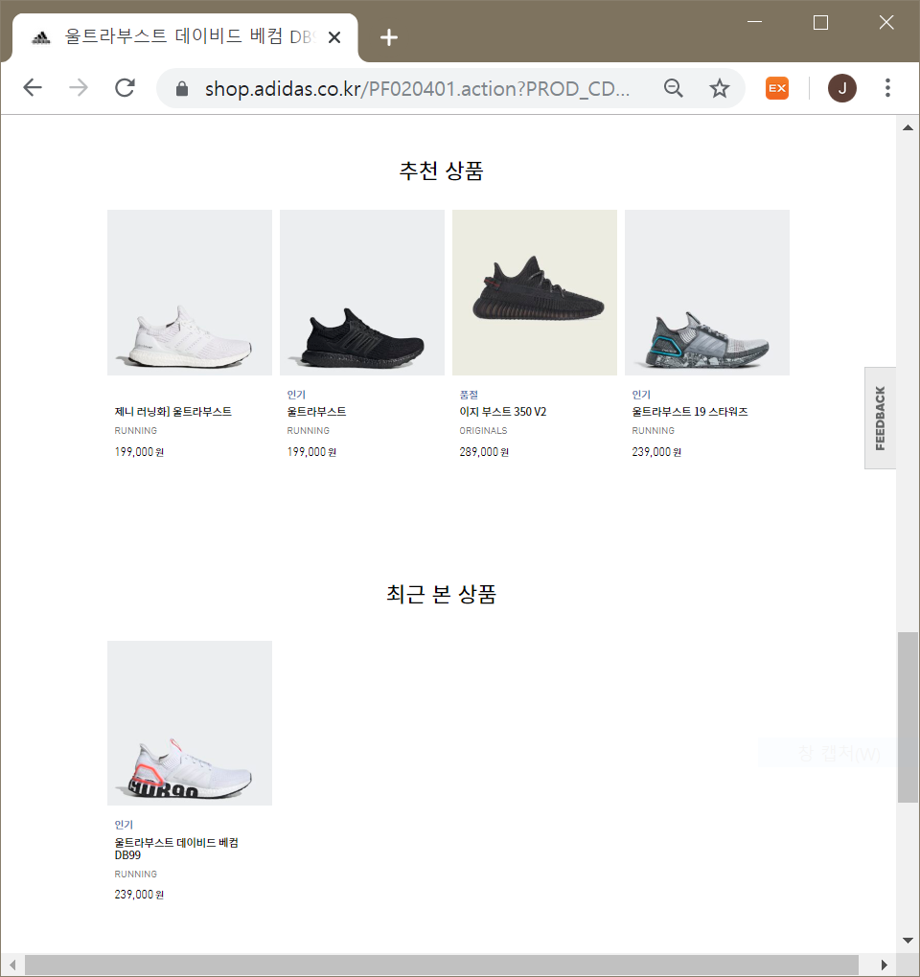
Motivation
Clothes, shoes websites recommend products of same label/group, not based on style.
Must search manually to find similar style.
Notes:
So, we wanted to create an AI- based recommender system that searches products similar to the one you chose.

Slide 3
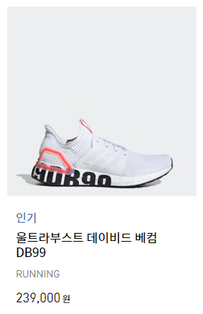
Motivation
Style is a visual property
Textual labeling is inefficient
Supervised vs
Unsupervised
Notes:
A white shoe with a rubber band across the middle, with an orange trapezoid on top of black letters 9DB-circle-circle.

Slide 4
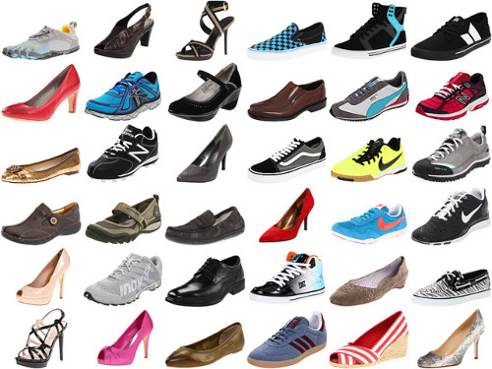
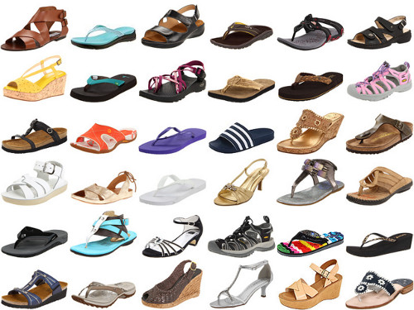
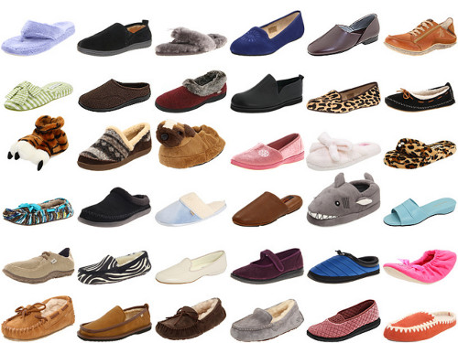
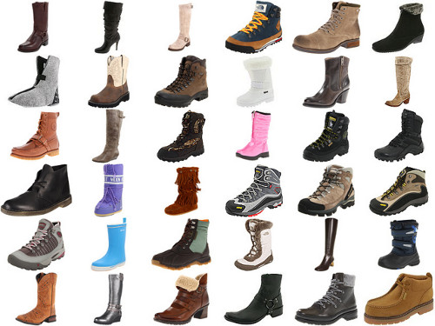
Dataset Preparation
50027 images (136*136) of shoes of all kinds and ages (.zip)

Slide 5
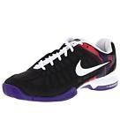
Unsupervised Variational Auto-encoder
CNN-VAE architecture
Latent vector
μ
Encoder
Network
(conv)
Decoder
Network
(deconv)
σ
Sampled latent vector

Slide 6
Live Demonstration

Slide 7
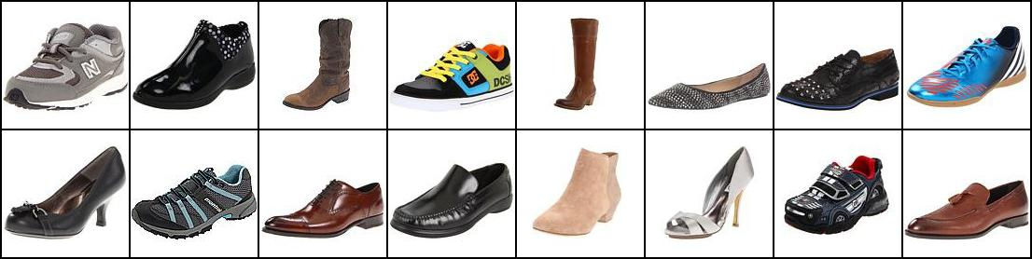
Results
Original images

Slide 8
Results
Original images
Reconstructed images

Slide 9
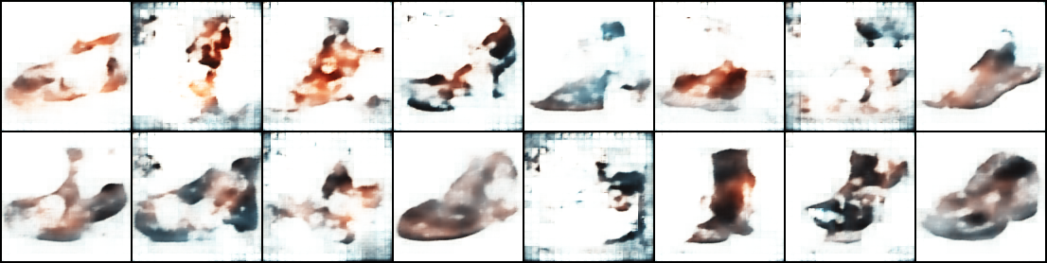
Results
Shoe reconstruction from random noise

Slide 10
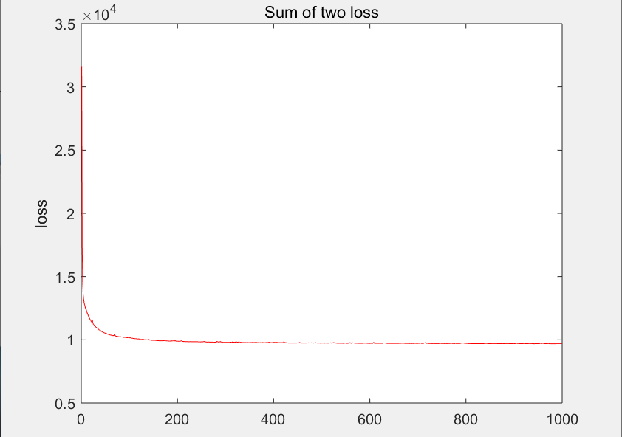
Analysis
Total loss

Slide 11
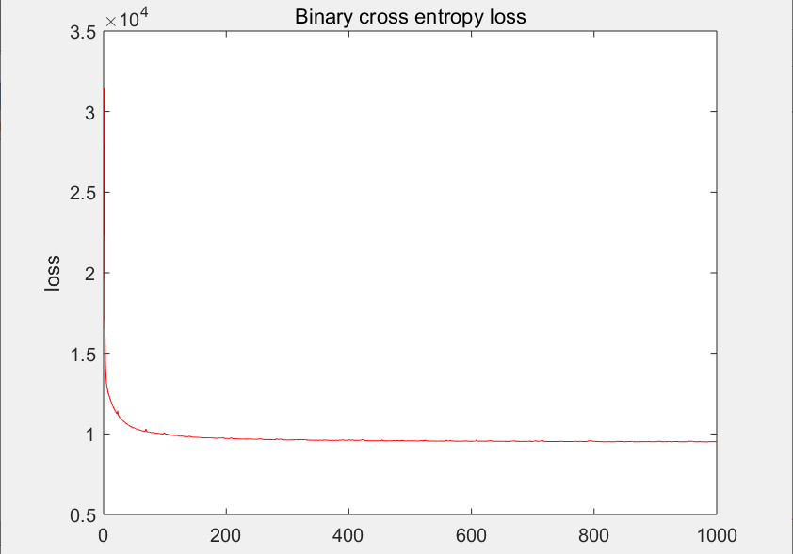
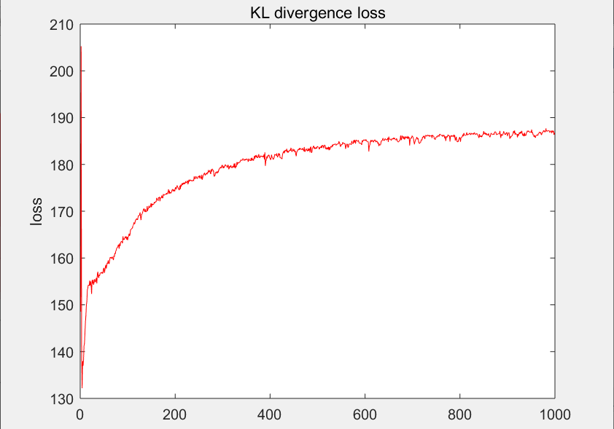
Analysis
Binary cross entropy loss
Kullback-Leibler divergence loss

Slide 12
Thank you.

